Slide 1


Recreational screen media use and its effect on physical activity, sleep, and mental health in families with children
PhD Defence
Jesper Schmidt-Persson
Exercise Epidemiology, Centre for Research in Childhood Health
University of Southern Denmark
Notes:
Thank you for the opportunity to defend my PhD thesis here today.
Thank you to the assessment committee.
The work conducted in this PhD was funded by the European Research Council.
The grant was received by my supervisor Anders Grøntved.

Slide 2





What is recreational screen media use?
Any type of engagement with a screen-based device outside school or work hours
Game consoles
Computers
Televisions
Tablets
Smartphones
Notes:
To be clear, I would like to start with how I defined recreational screen media use.
Any type of engagement with a screen-based device (e.g. tablet, smartphone, computer, television, Gameboy, E-reader etc.) outside school or work hours which is not related to school or work (except in Paper I where homework on screen devices were included).
Now we are on the same page..

Slide 3



Why study recreational screen media use?
New technogies might affect people differently?
(Wartella et al. 2020, Orben et al. 2020)
Notes:
But, why even study recreational screen media use and how does it affect health?
Technology panics were also present when movies, radios, and televisions were introduced.
Nevertheless, todays new technologies like smartphones and tablets could affect people differently compared to television, radios and movies. For example: You can bring your smartphone or tablets anywhere and it is constantly connected to the internet, and you can engage with other people.
This might not be a problem or unhealthy, but research is needed in order to know if concerns are relevant.

Slide 4




Unfavorably associated with health outcomes
Are these associations causal?
Poorer cardiovascular health
Obesity
Shorter sleep duration
Poorer sleep quality
Poorer mental health
Increased perceived stress
Lower physical fitness
(Stiglic et al. 2019, Vahedi et al. 2018, Martin et al. 2020, Wang et al. 2019)
Notes:
Previous studies have found that screen media use is unfavorably associated with several health outcomes including...
Obesity, poorer cardiovascular health, Shorter sleep duration, poorer sleep quality, lower levels of physical activity, and Poorer mental health.
But, are the observed assications causal?
The oberved associations are mainly from observational studies (often cross-sectional), which may lead to reverve causation bias.
Observationelt/cross-sectional
Reverse causation bias

Slide 5

Screen media use recommendations
The Danish Health Authority: ”Parents should help children create varation between screen-based behaviors and other activities”
World Health Organization: ”To limit sedentary time (particularly recreational screen time)”
The Australian and Canadian guidelines: “<2 hours/day for 5-17 year-olds”
But, recommendations are based on low certainty evidence.
(www.sst.dk, www.who.int, www.health.gov.au, www.csep.guidelines.ca)
Notes:
Several organisations have acknowlegded screen media use as a public health concern and formulated recommendations for children’s screen media use.
The Danish Health authority (parent should help children create varation between screen-based beahaviors and other activities)
WHO recommend limit sedentary time (particularly recreational screen time)
The Australian and Canadian guidelines (<2 hours/day for 5-17 year-olds)
All recommendations are based on low certainty evidence. We do not know, how much is too much screen time..
Which leads me to the overall objective of my thesis

Slide 6
Overall aim of the thesis
To describe recreational screen media use among Danish school-aged children and explore the role of parental education, family structure, and household screen media rules
To investigate the effects of limiting recreational screen media use on physical activity, sleep, mental well-being, and biomarkers of stress in families with children
Notes:
Overall aim of the thesis was...
To describe recreational screen media use among Danish school-aged children and explore the role of parental education, family structure, and household screen media rules, and to investigate the effects of limiting recreational screen media use on physical activity, sleep, mental well-being, and biomarkers of stress in families with children.

Slide 7
Paper I Recreational screen media use in Danish school-aged children and the role of parental education, family structures, and household screen media rules Preventive Medicine (February 2022)
Paper II Effects of limiting recreational screen media use on physical activity and sleep in families with children: A cluster randomized clinical trial JAMA Pediatrics (May 2022) Paper III Effects of limiting digital screen use on mental well-being, mood, and biomarkers of stress in adults npj Mental Health Research (September 2022 - accepted)
Notes:
Let’s start with the background for paper 1

Slide 8

Background
Previous studies have found screen media use to be correlated with age, sex, socioeconomic status, family structure, and screen media rules (Rideout et al. 2021, Langøy et al. 2019, Lauricella et al. 2020)
Lack of descriptive studies on modern screen media use among Danish children (only outdated or commercial reports are available)
Lack of studies exploring correlates of screen media use among Danish children
Notes:
Previous studies have found screen media use to be correlated with age, sex, socioeconomic status, family structure, and screen media rules (Rideout et al. 2021, Langøy et al. 2019, Lauricella et al. 2020)
Lack of descriptive studies on modern screen media use among Danish children (only outdated or commercial reports are available)
Lack of studies exploring correlates of screen media use among Danish children. Are correlates the same in a Danish context?

Slide 9

Objectives of Paper I
To describe Danish children’s use of recreational screen media devices
To explore the role of parental educational level, family structure, and household screen media rules
Notes:
The aim was to describe Danish children’s use of recreational screen media devices and explore the role of parental educational level, family structure, and household screen media rules

Slide 10
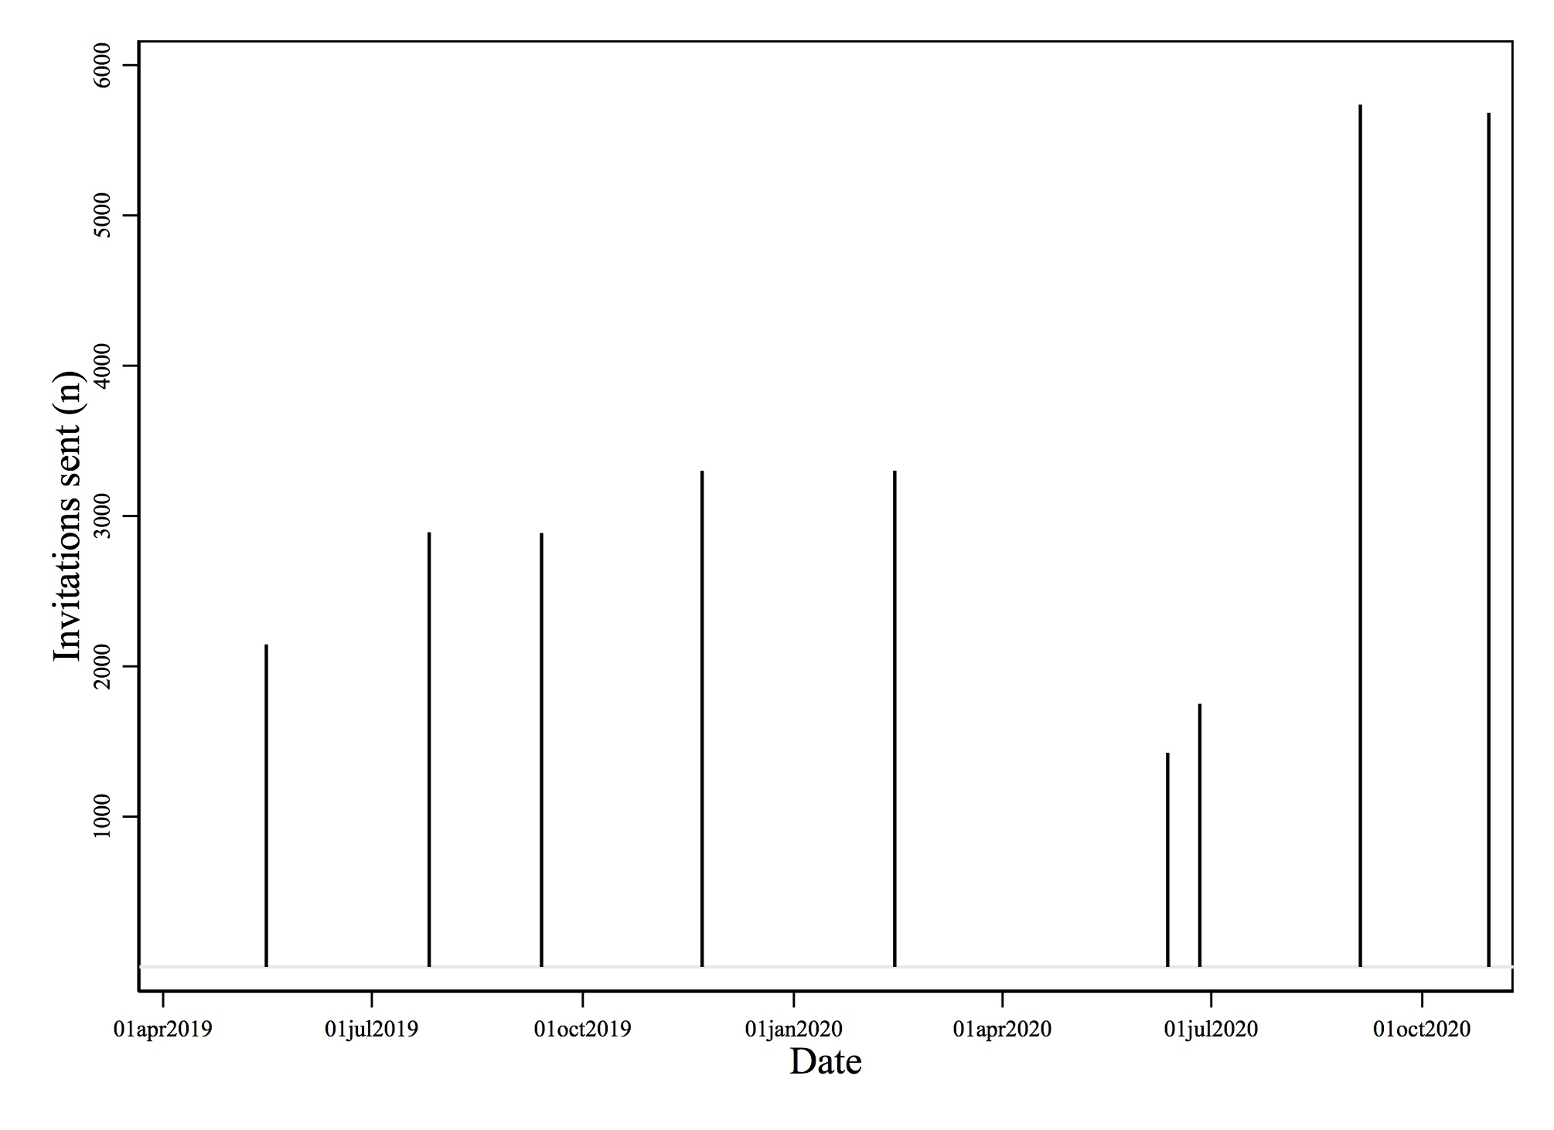
Methods
COVID-19 lockdown
A cross-sectional population-based study on screen media behavior among Danish children
One parent and one child in households with at least one child aged 6-10 years
Digital invitations were sent to 29.124 parents via e-Boks
5.274 provided complete responses (18%)
Notes:
A cross-sectional population-based digital survey study on screen media behavior among Danish children
The National Health Data Authority randomly chose one parent and one child in households with at least one child aged 6-10 years in ten different municipalities in the region of southern Denmark.
Digital invitations were sent to 29.124 parents via e-Boks
5.274 provided complete responses (18%)

Slide 11
Participant characteristics
 | Non-responders (n=22,304) | Partial responders (n=1,546) | Responders (n=5,274)
Children
Biological sex, % Girls/Boys | 48.6/51.4 | 50.3/49.7 | 48.3/51.7
Age, mean (sd) | 8.8 (1.4) | 8.7 (1.4) | 8.8 (1.4)
Ethnicity (% Danish/Other Western/Non-Western) | 87.1/2.6/10.3 | 75.1/4.3/20.6 | 91.6/1.9/6.5
Parents
Biological sex, % Female/Male | 58.6/41.4 | 64.1/35.9 | 67.7/32.3
Age, mean (sd) | 40.3 (5.9) | 40.4 (6.2) | 41.0 (5.6)
Notes:
Generally similar
Purple – Response proportion male and female.. Female parents were much more likely to answer the survey.

Slide 12
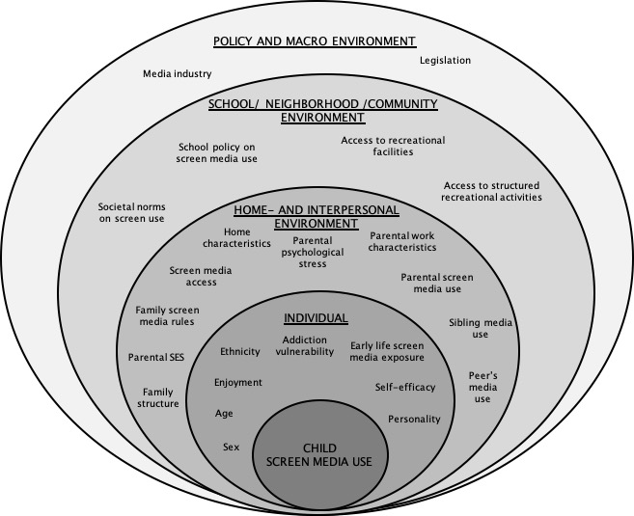
Socio-ecological model
(Klakk et al. 2020)
Notes:
Looking from a socio-ecological persperctive, this study describes screen media use on the an individual level and the home and interpersonal envrioment.

Slide 13
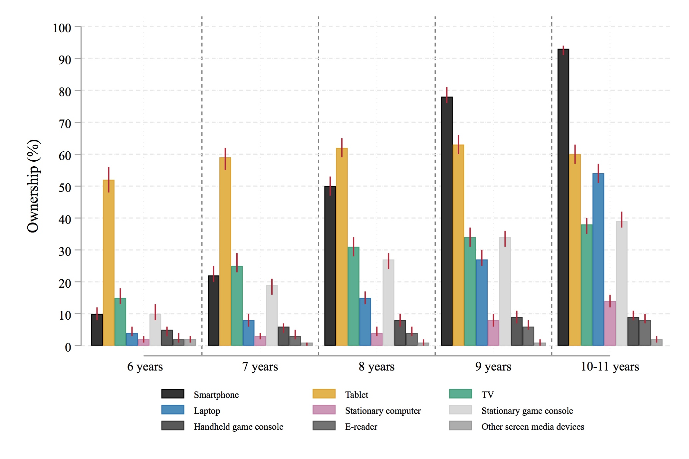
Device ownership
Non-response weighted proportions
Notes:
10-11 årige..

Slide 14
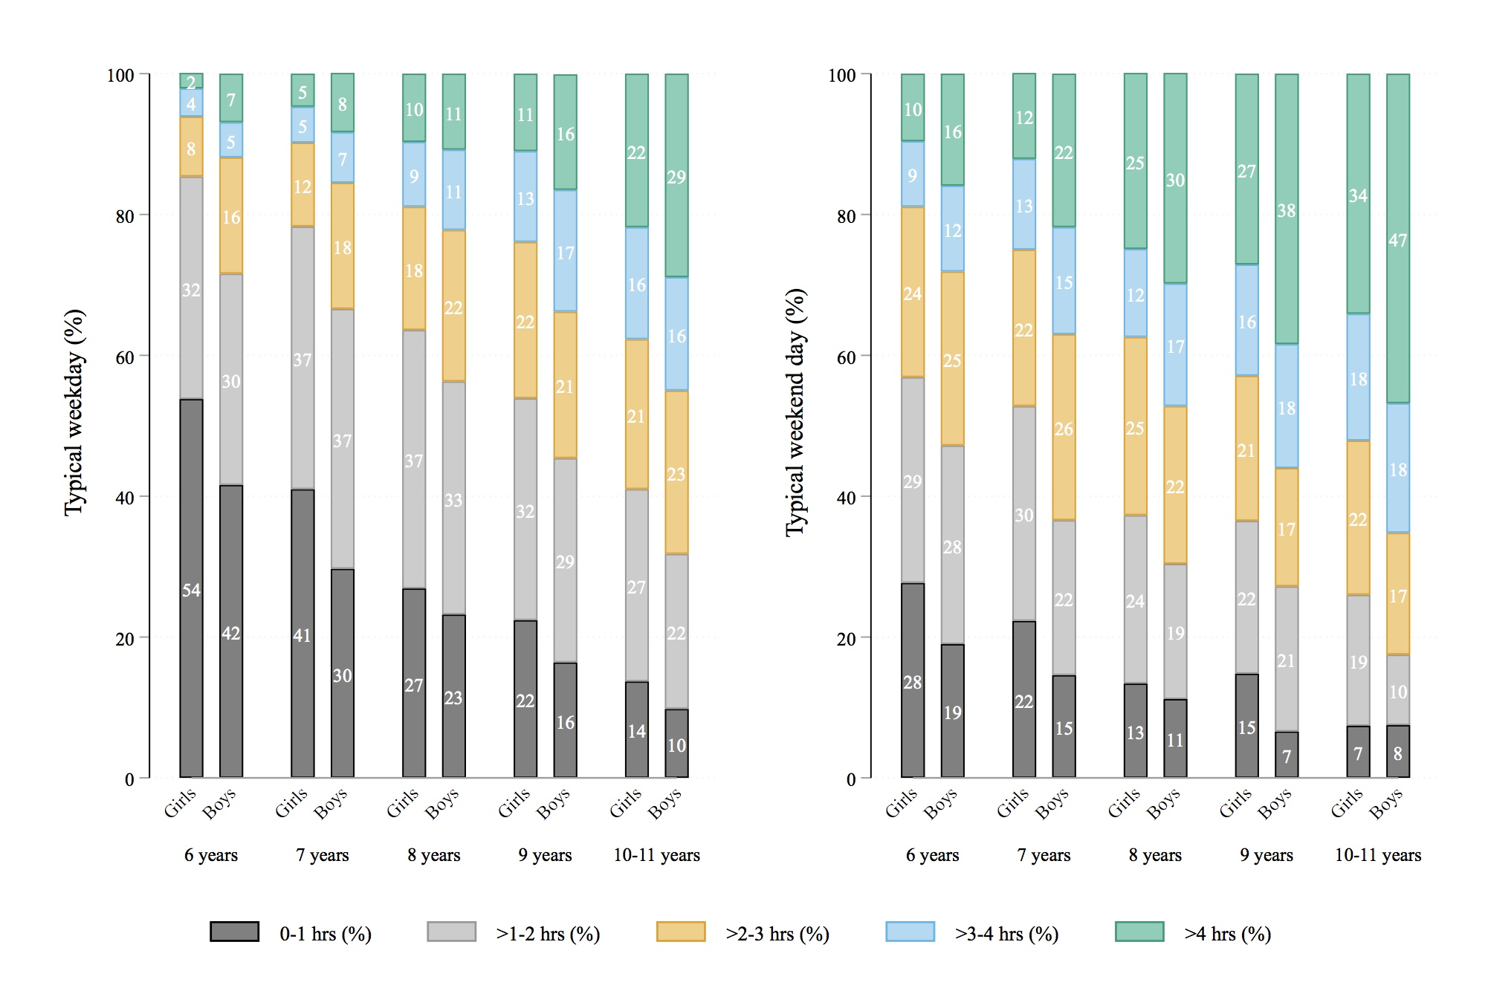
Recreational screen media use
Non-response weighted proportions
Notes:
Large difference between weekdays and weekend days and boys and girls.

Slide 15
Recreational screen media content
Non-response weighted proportions
Notes:
The figures present children’s screen media content according the parental reports. Their use is quite similar at this age, but boys generally spent less more time one screen media games.
The largest difference between weekdays and weekend days is that school-related activities is less prevalent during weekend days compared to weekdays.

Slide 16
Problematic screen media habits
More than 4 hours/day of recreational screen media use
Possible displacement of other activities (e.g. physical activity or social activities)
Screen use within 30 minutes before bedtime
Possible delayed bedtime leading to shorter sleep duration
Screen use within 30 minutes after awakening
Possible earlier awakening leading to shorter sleep duration

Slide 17
Parental educational level and problematic screen media habits
Similar findings for screen media use before bedtime and after awakening
Adjusted for children’s sex, age and ethnicity, and parental age and sex.
Notes:
Træk de centrale resultater ud af figuren

Slide 18
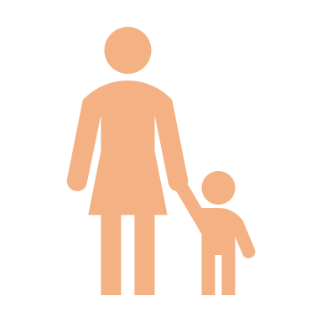
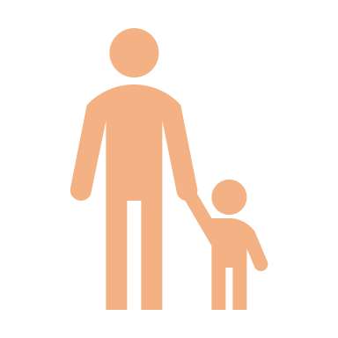


Family structure and problematic screen media habits
Children living with a single parent or who are an only child
Higher odds (21-46%) of using screen media devices before bedtime everyday
No consistent findings for the other problematic screen media habits
Adjusted for children’s sex, age and ethnicity, and parental age and sex.
Notes:
Træk de centrale resultater ud af figuren

Slide 19
Household screen media rules
”Child must ask a parent before using screen media devices”
Hours/day of screen media use (Beta Coefficient (95% CI))
Adjusted for parental educational level, parental screen media use, single-parent home (yes/no), children’s sex, age, and ethnicity.
Notes:
Figure only present one of the investigated rules.

Slide 20

Contributions of Paper I
Provides up to date knowledge on Danish children’s screen media habits
Device ownership
Screen media use and content
Confirms that previously observed relationships are present among Danish children
Socioeconomic gradient in problematic screen media habits
Notes:
Provides up to date knowledge on Danish children’s screen media habits
Confirms that previously observed relationships among other populations are present among Danish children
Socioeconomic gradient in problematic screen media habits

Slide 21



Discussion
Use of parent-reported screen media use
Selection bias?
Definition of problematic screen media habits?
Associational analyses
Unknown or residual confounding
Reverse causation bias
Notes:
Use of parent-reported screen media use
Selection bias?
Definition of problematic screen media habits?
Associational analyses
Confounding
Reverse causation bias

Slide 22
Next step?
Are Danish children’s screen media behaviors affecting their health behaviors?
Notes:
So, now we know something about the prevalence of screen media use and its correlates.
But, does Danish children’s screen media behaviors aactually affect their health behaviors?
This question leads me to paper II and III of the thesis.

Slide 23
Paper II Effects of limiting recreational screen media use on physical activity and sleep in families with children: A cluster randomized clinical trial JAMA Pediatrics (May 2022) Paper III Effects of limiting digital screen use on mental well-being, mood, and biomarkers of stress in adults npj Mental Health Research (September 2022 - accepted)

Slide 24

Background
The question still remains:
Is screen media use causally related to health outcomes?
Large proportion of children and adults do not meet recommendations for physical activity (Steene-Johannessen2020, Guthold 2018)
16% young men and 23% young women report having sleep problems (Danish National Health Profile 2021)
Mental health issues are increasing among Danish young adults (Danish National Health Profile 2021)
Few experimental studies have important limitations
Often lab-based or effectiveness
Use of self-reported screen media use
Use of self-reported outcome measures
Lack of assessment of intervention compliance
Notes:
Large proportion of children and adults are do not meet recommendations for physical activity (Steene-Johannessen2020, Guthold 2018)
16% young men and 23% young women report having sleep problems (Danish National Health Profile 2021)
Mental health issues are increasing among Danish adults (Danish National Health Profile 2021)
Few experimental studies aimed at reduced screen media use have been designed to investigate the causal relationship physical activity, sleep, and mental health measures in children and adults
Important limitations of previous studies (often lab-based or effectiveness)
Use of self-reported screen media use
Use of self-reported outcome measures
Lack of assessment of intervention compliance
The question still remains: Is screen media use causally related to health outcomes?

Slide 25
Suggested mechanisms
Time displacement (physical activity, delay bedtime)
Light exposure (suppress sleepiness, delay circadian rhythm, alter sleep architecture)
Screen content (increase arousal before sleep)
Endless availability of screen media devices (feelings of stress and guilt)
Disruption of fundamental behaviors (eating, exercise, sleep induce stress)
Notes:
But what are the pathways through which screen media use may affect different health behaviours?
Time displacement (physical activity, delay bedtime)
Light exposure (suppress sleepiness, delay circadian rhythm, altered sleep architecture)
Screen content (increase arousal before sleep)
Endless availability of screen media devices (feelings of stress and guilt)
Disruption of fundamental behaviors (eating, exercise, sleep → increased stress

Slide 26

Objectives
Paper II
To investigate the effects of reducing recreational screen media use on physical activity and sleep parameters in children and adults
Paper III
To investigate the effects of reducing recreational screen media use on overall well-being, mood, and daily biomarkers of stress in adults
Notes:
The objective of Paper II was to investigate the effects of reducing recreational screen media use on physical activity and sleep parameters in children and adults
The objective of Paper III was to investigate the effects of reducing recreational screen media use on overall well-being, mood, and daily biomarkers of stress in adults

Slide 27

Methods
”Lab study under real world conditions”
We did not aim to investigate pragmatic effectiveness of the intervention
Lab
Notes:
”Lab study under real world conditions”
Create contrast in recreational screen media use between two groups of families
We did not aim to investigate pragmatic effectiveness of the intervention...
Særligt designet til at undeersøge fysisk aktivitet.
Vigtighed af compliance (Skema fra Anders)

Slide 28


2-week screen reduction intervention
Hand over smartphone and tablets
Reduce recreational screen media use to <3 hours/week
Installation of screen media use monitors
Intervention reminders
Family planning
Financial reimbursement (500 DDK/family)
Notes:
Several intervention components, all aimed at increasing compliance to reduction of screen media use.
Hand over smartphone and tablets
Reduce recreational screen media use to <3 hours/week
Installation of screen media use monitors
Intervention reminders
Family planning
Financial reimbursement (500 DDK/family)
Theoretical underpinning
Screen media restriction components SCT level targeted (Behavior element targeted)
Planning the course of the screen time restriction period. Hanging notes where family members can see them. Personal / environment (Goal setting, self-regulation)
Meeting the same individual from the research team during several meetings throughout the SCREENS trial Personal (Self-regulation)
Emphasizing the project as a family project, including parents as role models Personal and environment (Modelling)
Installation of screen time monitors on household devices Environment (Self-regulation)
Placing three to five ‘intervention reminders’ in the household Environment (Self-regulation)
Motivation and encouragement midway through the two-week screen time restriction Personal (Self-regulation)
Financial incentive upon completion of study Personal (Extrinsic reward, self-regulation)

Slide 29
Study design
Cluster randomized controlled trial
Recruitment based on the populations-based survey (Paper I)
”Yes” to hear more about the trial n = 1420 families
Phoned
eligible families
n = 408 families
Agreed to information meeting n = 116 families
Notes:
Therefore, we conducted a cluster randomized controlled trial.
We recruited participants thorugh the population -based survey described in paper I.
Eligibility criteria
• At least one adult and one child in the household were willing to participate
• At least one participating adult and all participating children were able to handover their
smartphone(s) and tablet(s) if allocated to the intervention group
• The family members (mostly the adults) were motivated to reduce leisure screen media use for a
two-week period

Slide 30
Trial overview
2-week screen reduction intervention n=45 families
7-day measurement protocol
Baseline n=92 families
Randomization n = 89 families
7-day measurement protocol
2-week control (usual screen media use) n=44 families
7-day measurement protocol
Objective screen media tracking
SDU Device Tracker application (smartphones, tablets, computers)
Television monitor (all household televisions)
Notes:
Block randomizartion, allocation concealment, sequence generation..

Slide 31

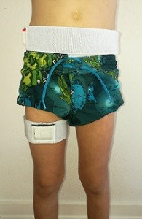
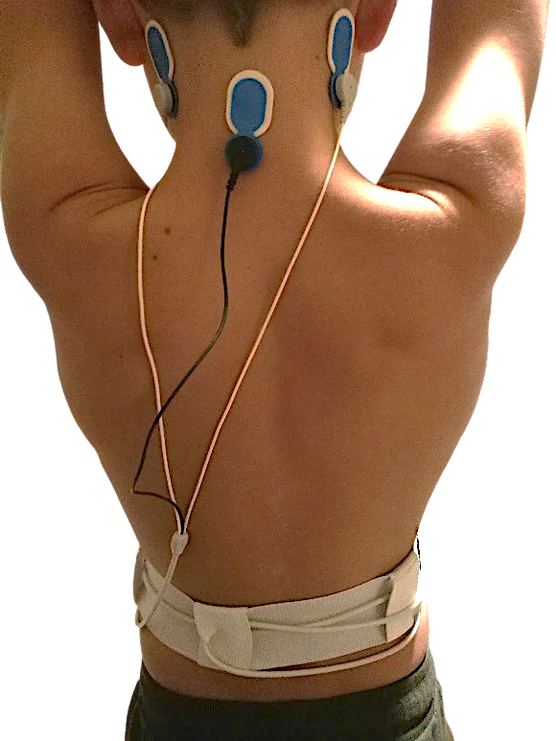
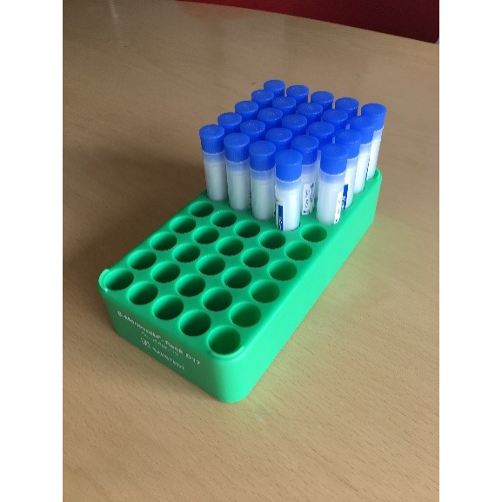
7-day measurement protocol
Children and adults
Adults
Physical activity
Accelerometry
7 days
Sleep
Single channel EEG
3 nights
Biomarkers of stress
Salivary samples
3 days
Mental health
Questionnaires
Notes:
Two triaxial accelerometers in elastic belts for 7 days all 24 hours/day
Single channel EEG 3 nights
Diaries (awakening, bedtime, arrival and endtime of school/work)
Questionnaires on Mental health outcomes (WHO-well being index, Profile of Moods, Strengths and difficulties questionnaire)
Tilføj flere detaljer..

Slide 32
Primary outcome
Children’s time spent non-sedentary during leisure
Decistion tree algorithm classifies accelerometry data in 1-second epochs into activity types (standing, moving, walking, running, cycling) and sedentary body positions (lying, sitting) (Brønd et al. 2020)
Missing data imputed to allow for intention-to-treat analyses

Slide 33
Timing of participating families
COVID-19
lockdown
COVID-19
lockdown
Notes:
Overview of the timing of families participanting in the SCREENS trial.

Slide 34
Sample characteristics
 | Children n=181 | Adults n=164
Age, years | 9 | 41
Biological sex, % (females/males) | 55/45 | 54/46
Education, % (short-term/medium term/long-term) | - | 18/54/28
Recreational screen media use, hrs/week | 16 | 23
Slight imbalance in age between control and intervention group.
Control participants were older (children 1 year, adults 2 years)
Notes:
Children in the sample were 9 years old on average and adult awere 41 years old. Slightly more females participated in the trial.
28 % of the parent had a long education
Children used 16 hrs/week on recreational and adults used 23 hrs/week. The randomization procedure worked well, but there was a slight age imbalance between groups.

Slide 35
Intervention compliance
Control group Median 10.9 hrs/week
Intervention group Median 2.7 hrs/week
Control group Median 15.5 hrs/week
Intervention group Median 2.7 hrs/week
83 children were compliant (97%)
78 adults were compliant (95%)

Slide 36
Physical activity results
Adjusted for the baseline value of the outcome and age.

Slide 37
Sleep results
Adjusted for the baseline value of the outcome and age.
Notes:
Methodological differences...

Slide 38
Mental well-being and mood results
No between group difference for salivary biomarkers of stress
Adjusted for the baseline value of the outcome and age.
Notes:
Lav en figur!

Slide 39

Contributions of Paper II & III
Evidence for a causal relationship between screen media reduction in families and increased physical activity in children in the short term, but not adults
Large effect size: 45 minutes/day
Evidence for a causal relationship between screen reduction and better self-reported mental health and mood
Moderate to large effect size: Cohen’s d=0.72
No evidence for a relationship between screen media reduction and biomarkers of stress
No clear evidence for causal relationship between screen media reduction and sleep in adults
Notes:
Evidence for a causal relationship between screen media reduction in families and increased physical activity in children in the short term, but not adults
Large effect size (screen media difference between groups 1,1 hours/day for children)
Evidence for a causal relationship between screen reduction and better self-reported mental health and mood
Large effect size (Cohen’s d = 0.72)
No clear evidence for causal relationship between screen media reduction and sleep in children or adults

Slide 40


Discussion
Successful experiment (high intervention compliance)
Lack of blinding
Generalizability
No effect on sleep?
Intervention not designed specifically to affect sleep
The sample might be too healthy?

Slide 41

Conclusions of the thesis
School-aged children spend large amounts of their leisure time using screen media devices for recreational purposes
Socio-economic disparity, household screen media rules
Evidence that reducing recreational screen media use is causally related to increased physical activity in children and improved mental health in adults

Slide 42




Perspectives
How to develop of ”real life” implementable interventions?
Balanced use of screen media devices seems desirable, but what amount is just right? (Przybylski et al. 2020)
?

Slide 43
Acknowledgements
Anders Grøntved
Martin Gillies Banke Rasmussen
Line Grønholt Olesen
Jan Christian Brønd
Peter Lund Christensen
Søren Brage
Eli Puterman
Heidi Klakk
Sarah Overgaard Sørensen
Sofie Rath Mortensen
Niels Christian Møller
Jasmin Helledie
Henrik Baare Ibsen
All participants in the SCREENS project

